Slide 1
Egeria and Open Metadata
For Dojo Day 1
Mandy Chessell CBE FREng
Egeria Open Source Project Lead

Slide 2
Today’s reality – organizations buy lots of tools
Development
DevOps
Data Science

Slide 3

Egeria’s value
Egeria enables the sharing of knowledge between people and processes that use different tools and technologies
Increasing agility, collaboration and the availability of relevant data when making decisions.
Breaking down silos between traditional technologies such as data and applications; applications and infrastructure management; security and data.

Slide 4

This is not a new problem …
Over the years, our industry has gained plenty of experience discovering what does not work
Centralized metadata repository
“Just use our tools” – Single vendor lock in
Paper standards that each vendor implements
Bridges that copy metadata between tools
Bespoke point-to-point integrations between tools

Slide 5

What is different about Egeria
Open source, multi-vendor and client collaboration
Peer-to-peer architecture; retaining the value of each technology
Self-configuring, distributed, real-time exchange of knowledge
Scales from Raspberry Pi to multi-instance HA cloud deployment
Multi-tenant
Instance based security
Customizable through connectors

Slide 6
Egeria enables exchange of metadata between tools from different vendors
Development
DevOps
Data Science
Open and
Unified Metadata

Slide 7
What makes metadata integration hard?
Metadata standards are many and each covers a small subset of the integration space
Impedance mismatch in:
Terminology
Granularity
Capability
Availability
Technology
Low priority in offering managers eyes → leads to lack of investment resulting in minimal capability in vendor offerings

Slide 8
Three layers of challenge for Egeria
Maintaining coherence of metadata across the ecosystem
Connectivity to enable the exchange of metadata
Infrastructure to host the open metadata and governance logic

Slide 9
Three layers of challenge for Egeria
Maintaining coherence of metadata across the ecosystem
Deduplication
Profiling
Classification
Monitoring
Provisioning
Triage
Validation
Enforcement
Remediation
Enrichment
Connectivity to enable the exchange of metadata
Open Metadata Repository Cohort and Federated Queries
Versioning and Provenance of Metadata
Open Metadata Archives
Connector Interfaces and hosting
Multi-layered security
Specialist APIs and Topics
Effectivity Dating
User Interfaces
Metadata capture, transformation and storage
Third party technology metadata exchange (poll, listen, push, pull)
Type Definitions
Lineage and Mementos
Curation and Templating
Scheduling, Triggers and and Orchestration
Audit Logging, Monitoring and Alerting
Infrastructure to host the open metadata and governance logic
Administration
Multi-Tenancy
REST Endpoint
Server Management
Containerization
Transport-level Security

Slide 10
Reality check - hybrid multi-cloud world
Independent metadata Repository
New applications deployed to cloud
Mobile Apps
IoT devices and
systems
Business Partners
Sharing data
Linked metadata Repositories
Data Lake
Applications
Databases
Files
Applications

Slide 11



Knowledge is separated in space and time
Independent metadata Repository
New applications deployed to cloud
Mobile Apps
IoT devices and
systems
Business Partners
Sharing data
Linked metadata Repositories
Data Lake
I wonder what this means
Applications
I know
Databases
Files
Applications

Slide 12
Egeria embraces the complexity
Independent metadata Repository
New applications deployed to cloud
Mobile Apps
IoT devices and
systems
Business Partners
Sharing data
Linked metadata Repositories
Data Lake
Applications
Databases
Files
Applications
Egeria (orange) is deployed throughout the enterprise
and synchronizes metadata between the tools.

Slide 13
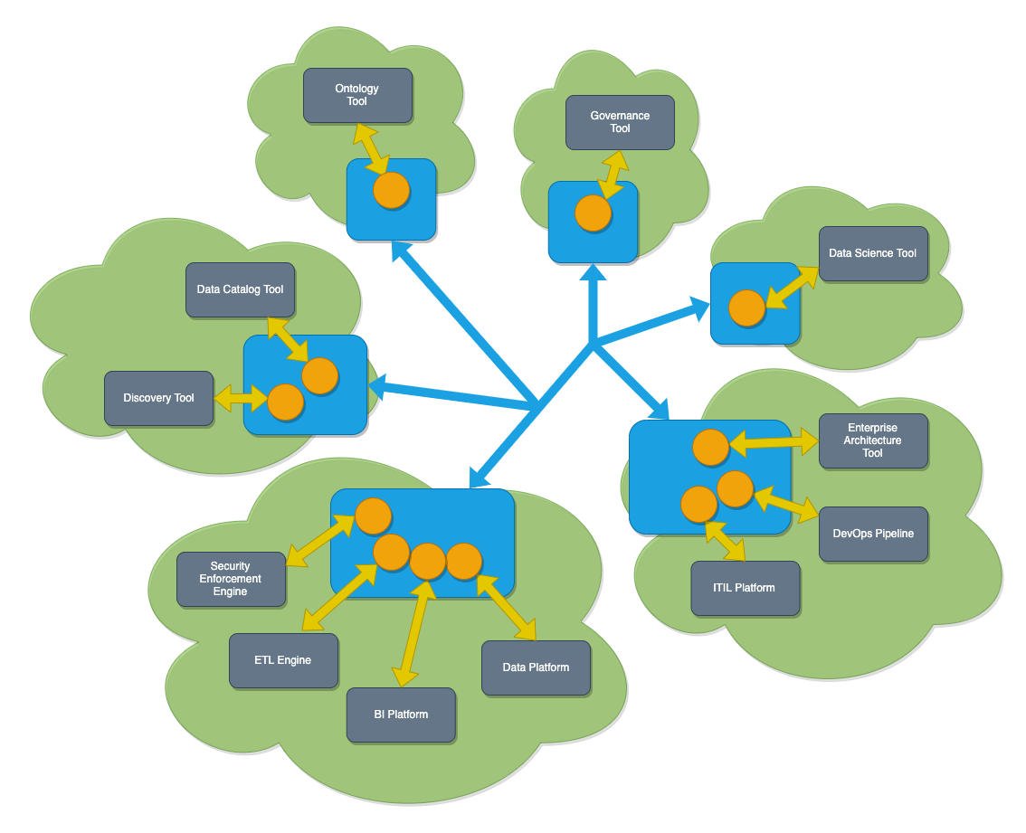
Egeria in operation
Egeria’s platform (in blue) runs in each deployment environment (cloud or on premises)
Egeria’s servers (orange circles) are deployed on the platform. Each server is specialized to support the metadata needs of specific technologies.
The interaction of the servers organizes the metadata exchange
https://odpi.github.io/egeria-docs/guides/planning/guide/

Slide 14
Egeria’s OMAG Server Platform
Open Metadata and Governance
Kubernetes
OMAG Server Platform
OMAG Server Platform
OMAG Server Platform
OMAG Server Platform
OMAG Server Platform
Multi-tenant
OMAG Server 1
OMAG Server 1
OMAG Server 2
OMAG Server 2
OMAG Server 3
OMAG Server 3
OMAG Server Platform
OMAG Server 1
Edge
https://odpi.github.io/egeria-docs/concepts/omag-server-platform/

Slide 15
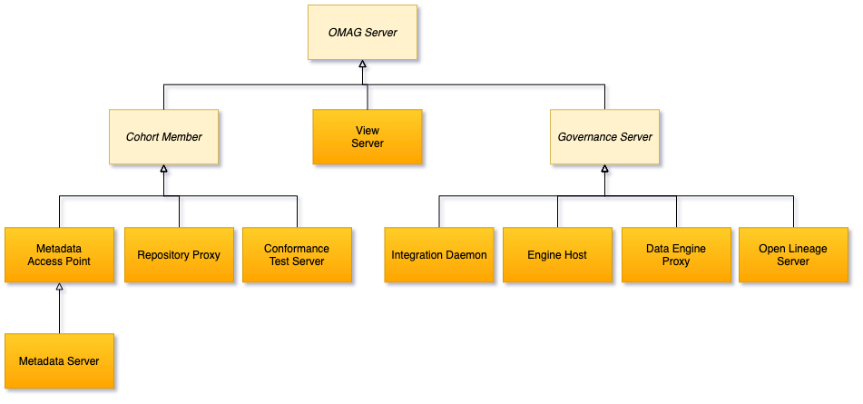
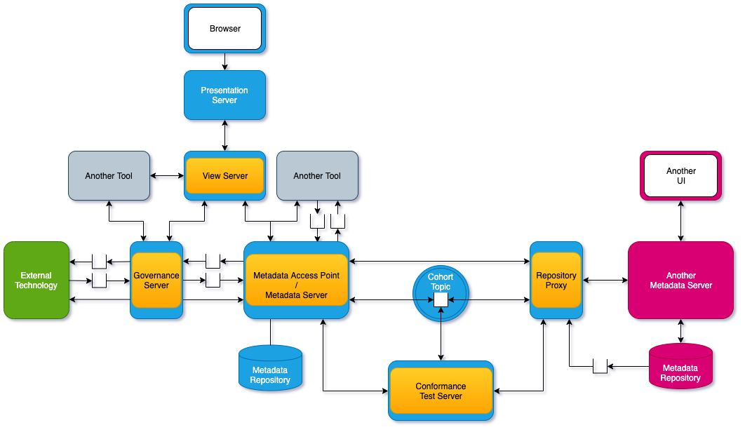
Egeria’s Open Metadata and Governance (OMAG) Servers
The cohort is the inner ring of
peer-to-peer metadata exchange.
The governance servers provide active exchange of metadata with tools, platforms, pipelines etc and governance of the metadata ecosystem.
Cohort

Slide 16
Scope of metadata covered
https://odpi.github.io/egeria-docs/types/
Strategy
4
Subject Area Definition
1
Teaming Metadata
(people profiles, communities, projects,
notebooks, …)
Policy Metadata (Principles, Regulations, Standards, Approaches, Rule Specifications, Roles and Metrics)
Business Objects and Relationships, Taxonomies and Ontologies
Augmentation
3
Organization
Feedback Metadata
(tags, comments, ratings, …)
Rollout
Classification
Business Attributes
Campaigns and Projects
Classification Schemes
Implementation
Mapping
Governance Actions and Processes
Rights
Management
Models and Schemas
2
Asset Collections
(Sets, Typed Sets, Type Organized Sets)
Reference Data
5
Instrument
7
Information Process
Instrumentation (design lineage)
Association
Information Views
Augmentation
Discovery
Metadata (profile data, technical classification, data classification,
data quality assessment, …)
Physical Asset Descriptions
(Data stores, APIs,
models and components)
0
Basic Types, Infrastructure and Systems
Access
6
Connectors

Slide 17
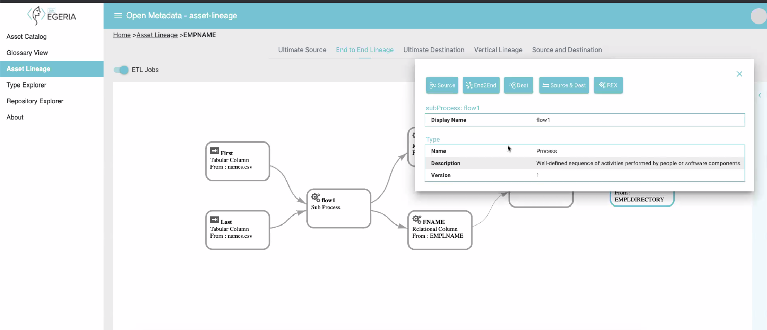
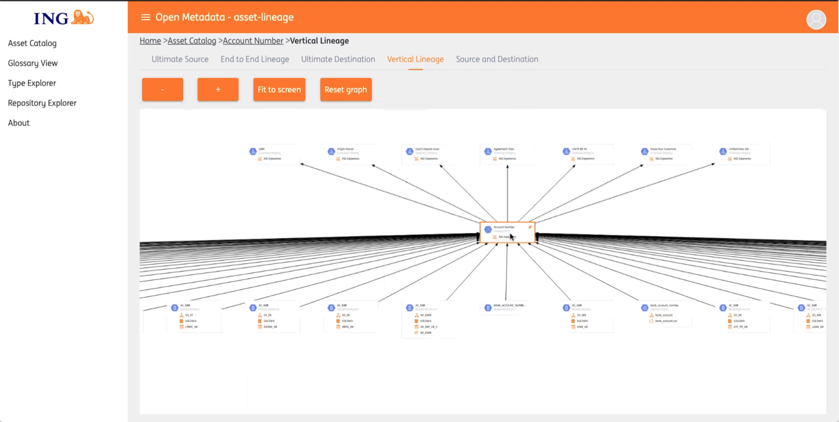
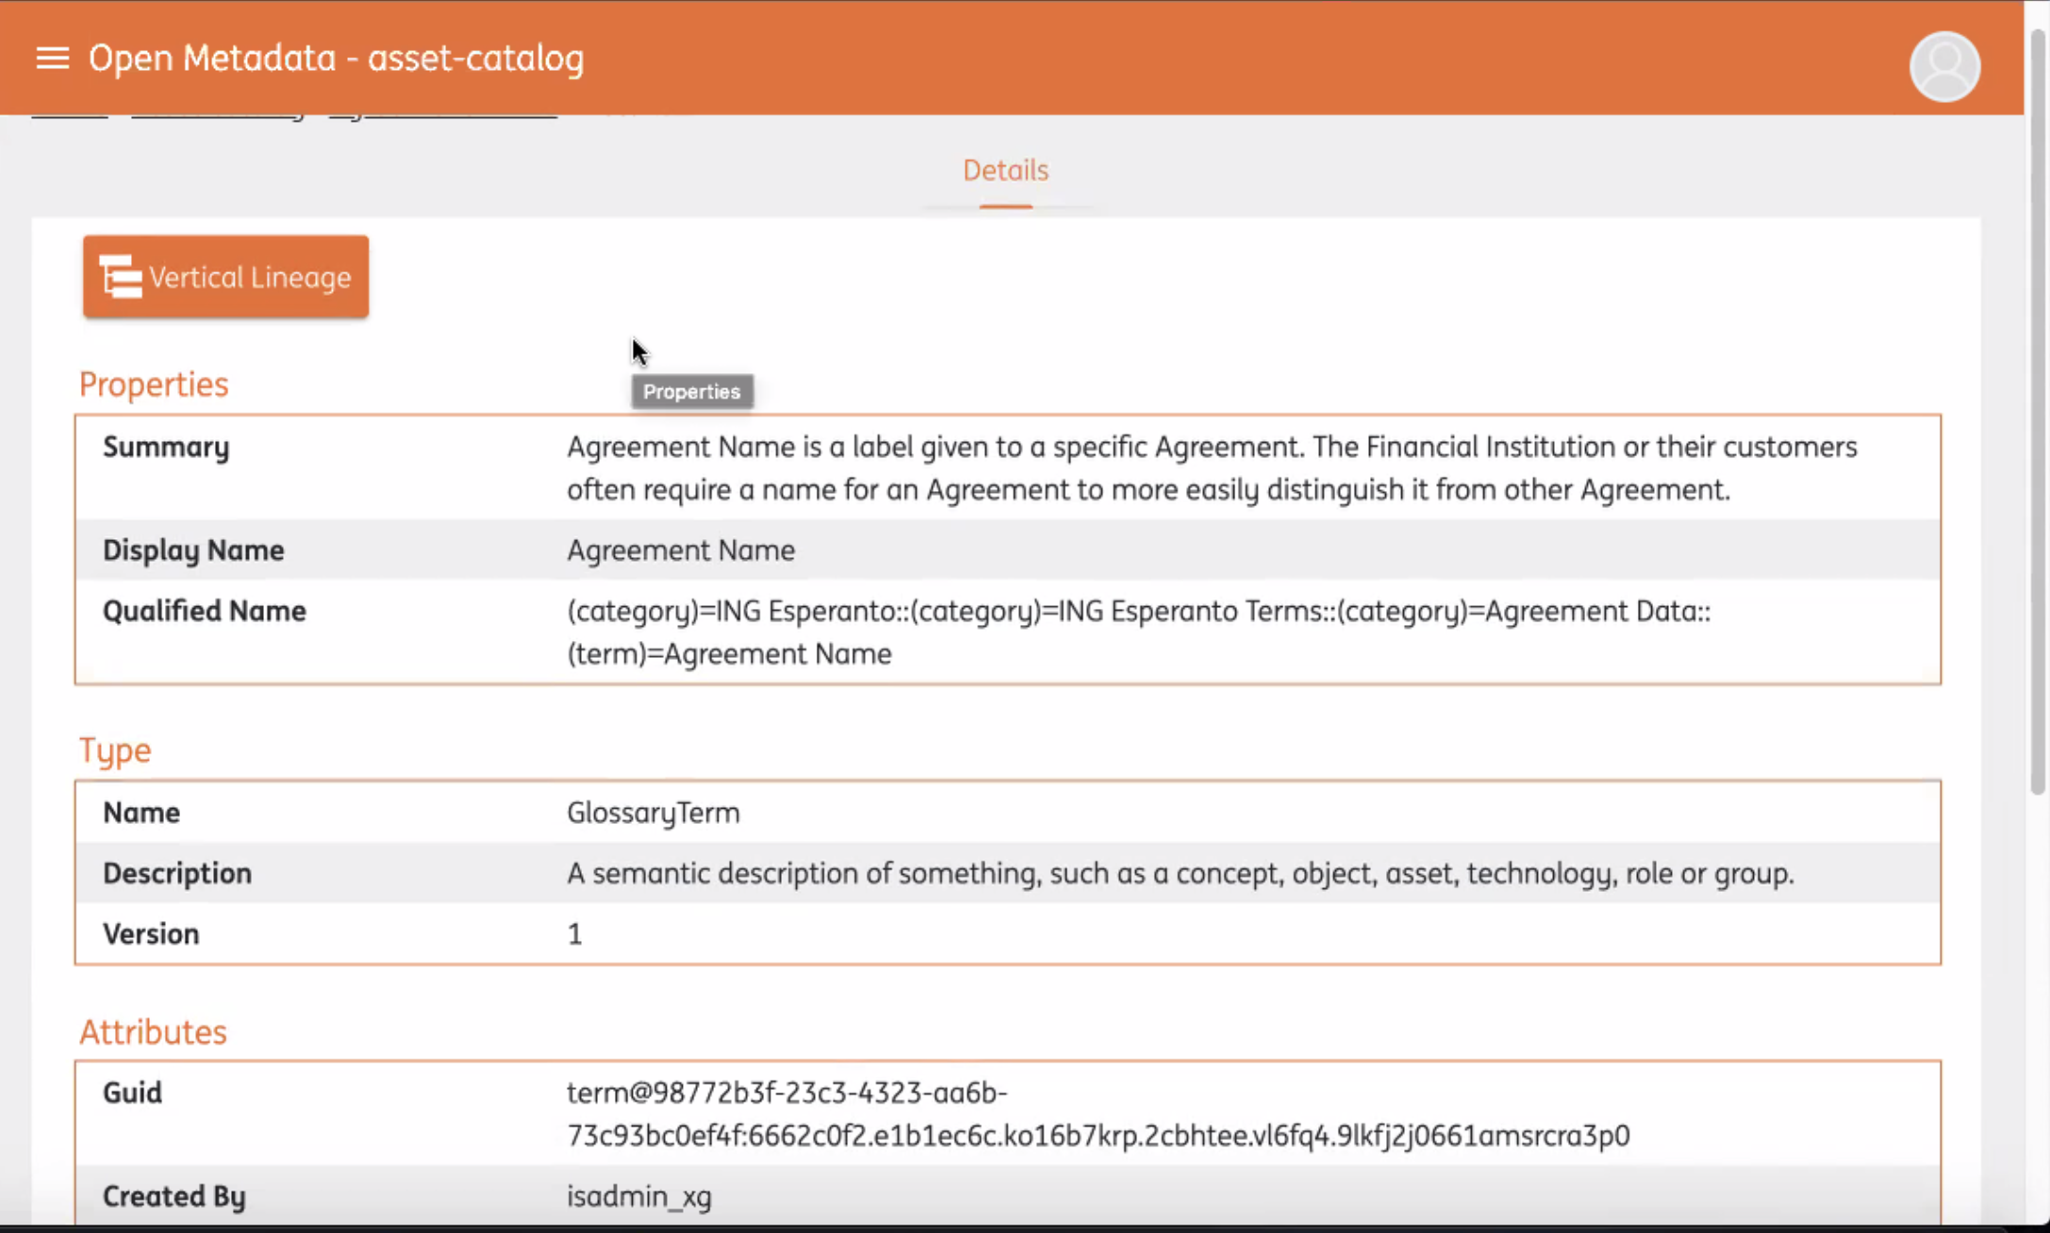
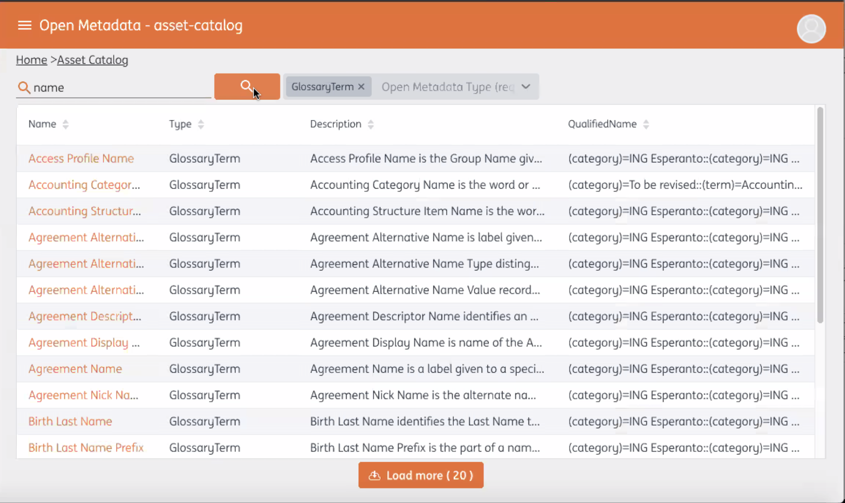
General User UI
Features
Glossary Search
Asset Search
Lineage
Repository browsing
Customizable look and feel for Enterprises

Slide 18
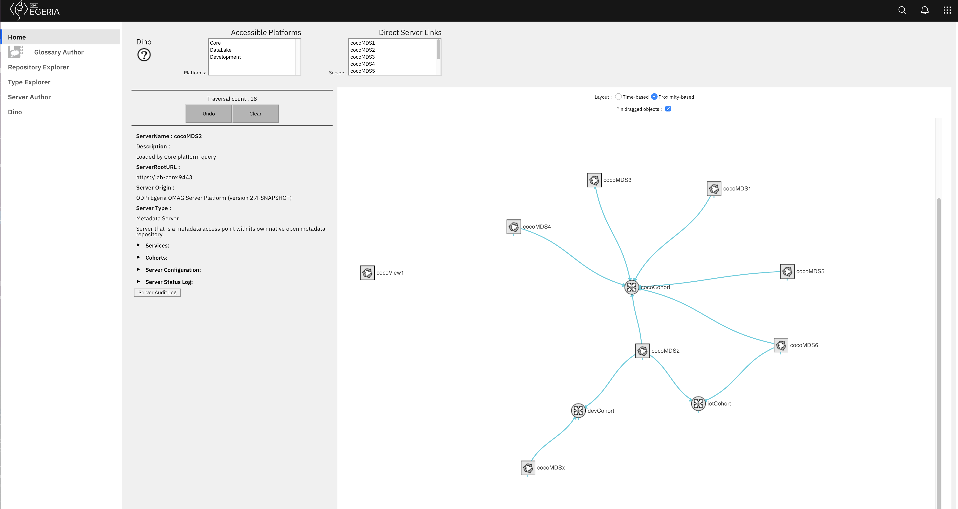
Open Metadata Ecosystem UI
Multi-tenant UI
Designed to support governance and open metadata teams

Slide 19
Egeria’s full stack
Egeria is more than code
Deployment
Education
Content packs
Solution cookbooks
Conformance test suite

Slide 20
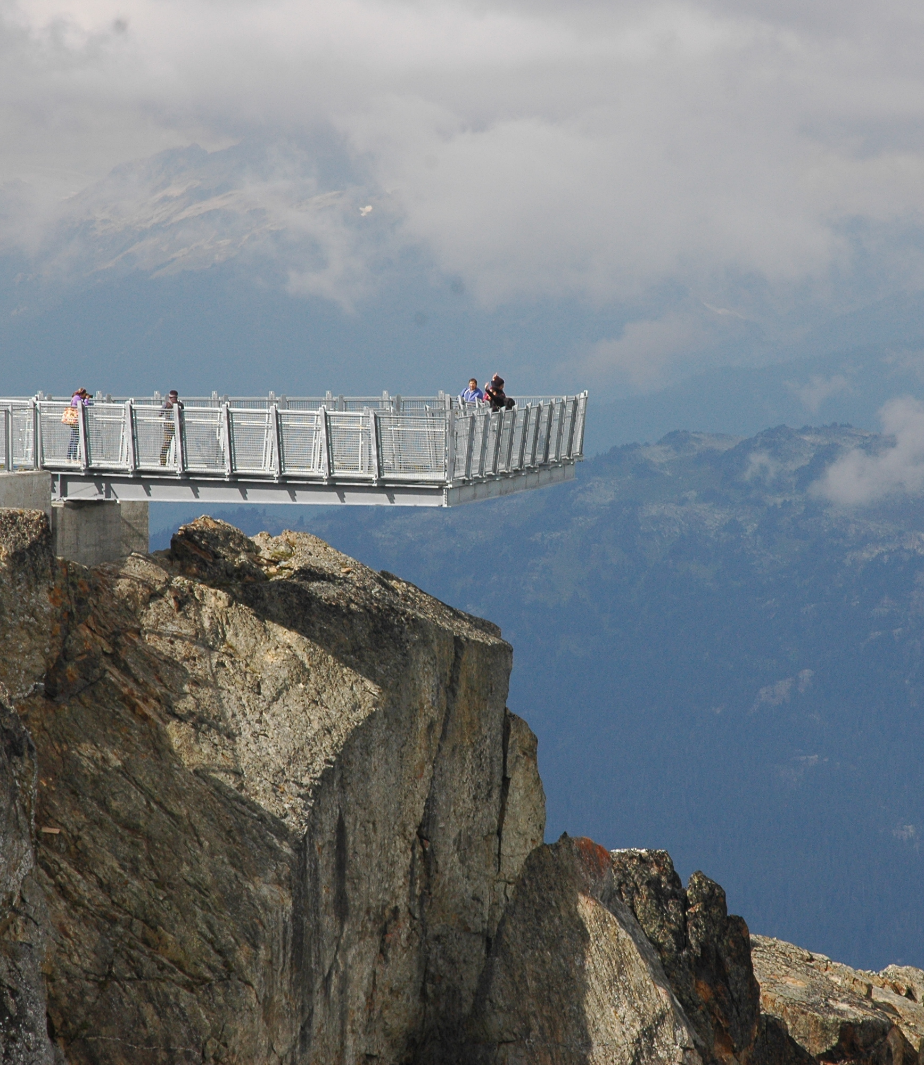
How does the Egeria community work
Iteratively perform a series of practical experiments that ignore the boundaries of traditional approaches.
Holistic approach
Open, public collaboration
Developing interest and partnership as we go
Agile development with feedback loop
Enterprise grade software

Slide 21
Why do vendors work with Egeria?
Linking old platform with new platform
Linking multiple versions of own product deployed across an enterprise
Offload integration implementation costs
Access to third party metadata:
open source technology’s and other vendor’s metadata
Governing third party technologies

Slide 22

Development Status
Development in plain sight
Monthly releases
What is ready, goes …

Slide 23
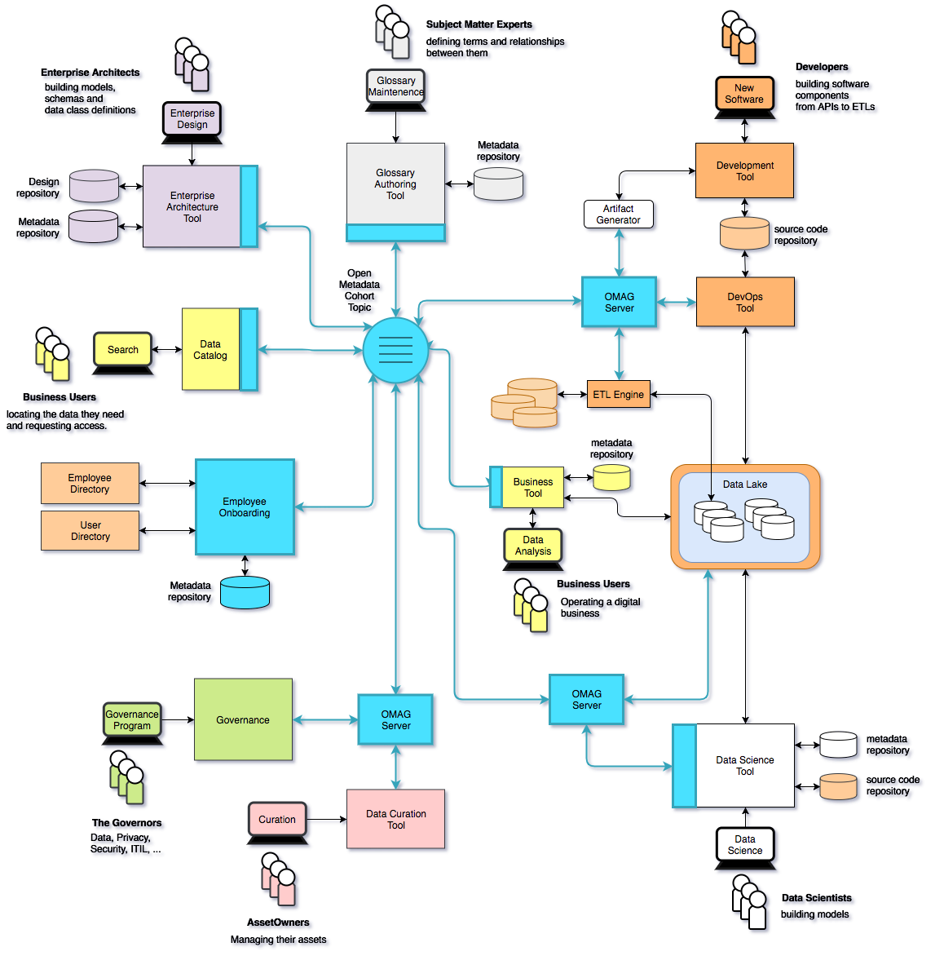
Using Egeria …
Eases the cost of metadata integration through
Comprehensive standards and libraries.
Active vendor recruitment program.
Provides direct support to many governance roles, filling the gaps between function offered through commercial tools.
Provides best practices and content packs to accelerate an organization’s journey to becoming data driven.

Slide 24
Open forum
z
z
z
z
z
z
z
Questions?

Slide 25
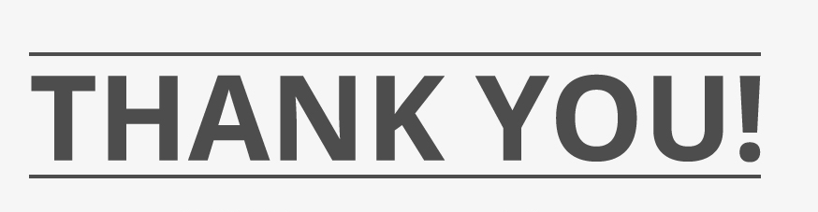


Slide 26
Achievements
Virtual graph of metadata maintained across distributed heterogenous metadata repositories.
Frameworks, APIs and connectors for minimizing integration cost for different types of technologies
Virtual repository explorer UI
Instance based security
Controlling visibility of assets through zones
Scalable, secure platform configurable and customizable through connectors
Purpose-based data access
Metadata versioning and provenance
Multi-tenant UI based on carbon
W3C semantic standards pattern for data model exchange
Automation of metadata acquisition through templates, daemons, discovery services and stewardship.
Classification of assets
Reference data management
Multi-technology collaboration and feedback
Multi-domain governance model
Digital service lifecycle, from business design, development, devOps and use.
Comprehensive open lineage services.
Metadata deduplication
700 linked open metadata types demonstrating how the knowledge from many tools can be linked together.
Open metadata repository interface proven for table, graph and hierarchical DB stores.
Enterprise queries and replication across heterogeneous technologies
Conformance test suite and mark
Automated configuration of data virtualization technology and security as new data sets are added to a data lake
Suite of persona-based labs and tutorial using Jupyter Notebooks.

